Slide 1


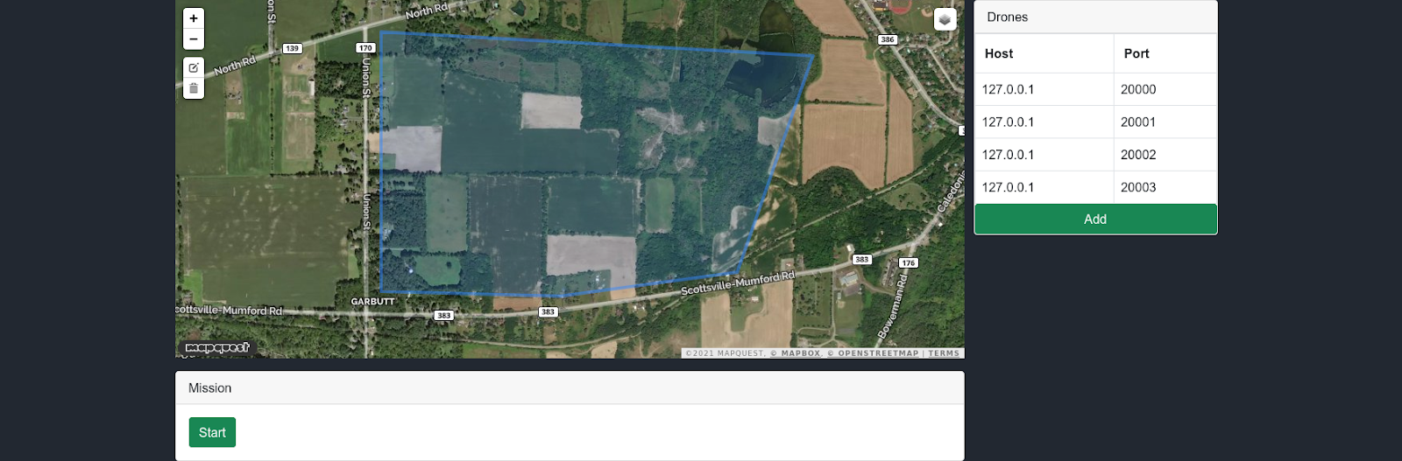
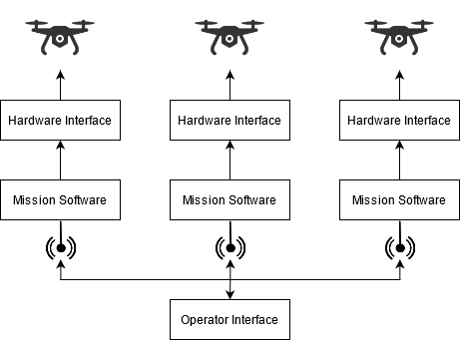
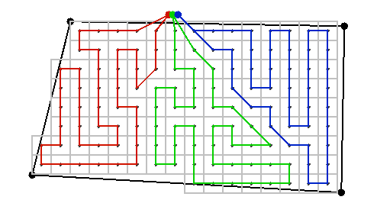
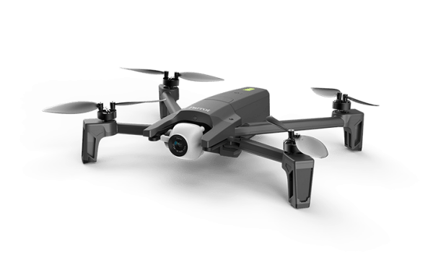
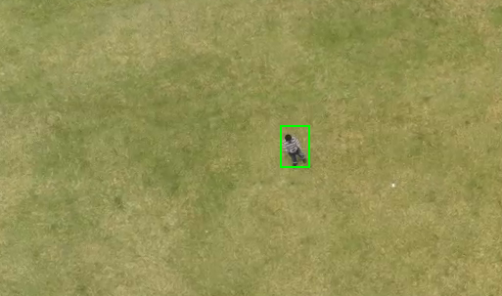
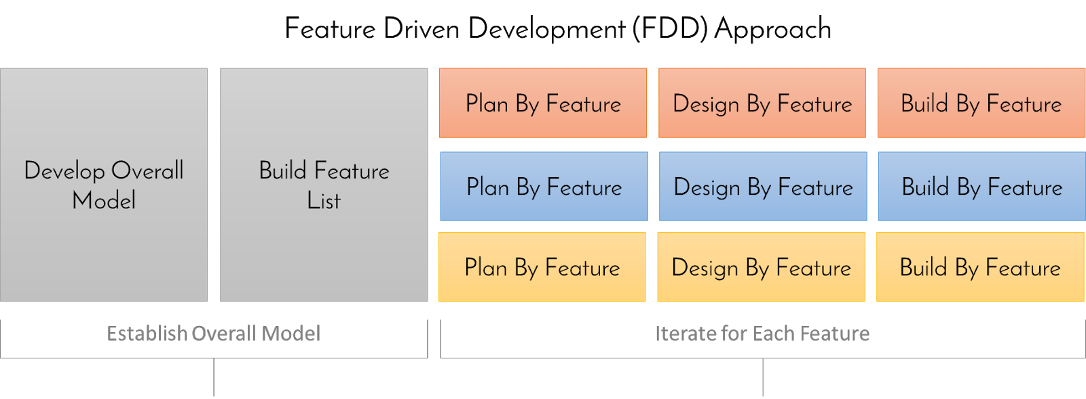





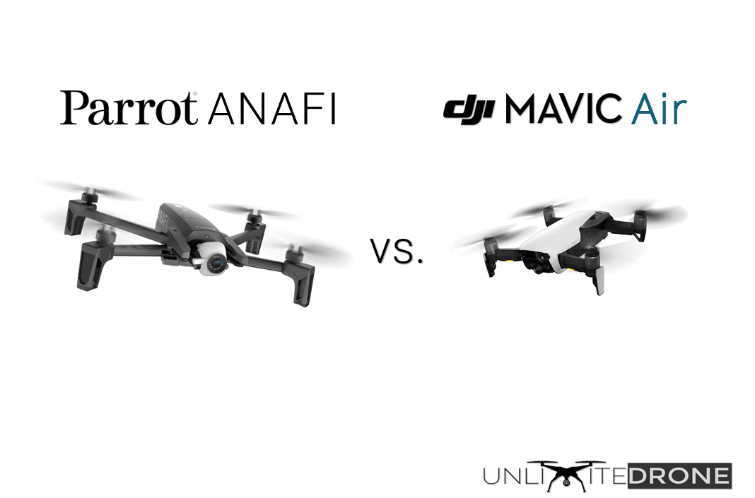
Search and Rescue Swarm
Team: Tyler Baldwin, Dominic Calabria, Jacob Wood
Sponsor: Daniel Wallach
Class of 2021
Faculty Coach: Scott Hawker
Background
A child has gone missing in a large field. They must be located quickly to guarantee their safe return. The only problem is it will take hours for humans to search through the field and coordinate form the ground. If only there was a way to quickly search from above to locate the missing child...
Step 1: Plan the Search Area
High-Level Architecture
A Python hardware interface is used to interface with Parrot drones through the Olympe SDK. This interface is responsible for sending movement commands to the drone as well as retrieving sensor data (such as GPS location and battery status).
Objective
Create a scalable, distributed system that will enable a swarm of drones to autonomously search an operator-designated area for a target. The swarm will be able to respond to system faults and new information by adjusting search patterns. The search algorithm will utilize any number of operational drones to quickly and efficiently search the area. Computer vision and GPS will be used to identify the target and report their location to the operator.
The core mission software
is implemented in Java and runs in a separate process. This component is responsible for functionality such as swarm communication and execution of search and computer vision algorithms.
Swarm Coordination
The Raft consensus algorithm is utilized to maintain a lead drone throughout the mission. The lead drone is responsible for the initial distribution of search points and altitude assignments, continuously monitoring the status of the swarm, and redistributing search points when contact with a drone is lost. In the event that the lead drone fails, the swarm will elect a new leader.
Step 2: Divide the Search Area
Path Planning
At the start of the mission, the search area is decomposed into grid cells with sizes dependent on the configured minimum altitude of the swarm - ensuring that a full cell can fit into any drone’s field of view. A load balancing algorithm - classified as a mixed integer linear programming problem - is then used to optimally distribute the area among the drones. Finally, a modified version of the Lin-Kernighan heuristic (a heuristic for the symmetric travelling salesman problem) is used to route each drone through its assigned points while balancing speed and energy consumption.
Computer Vision
Video frames are streamed from the drones and fed into the Okutama-Action Caffe pedestrian detection model. This model outputs locations of detections within the frame and their associated confidence levels. When a sufficient confidence level is achieved, the frame and approximate location of the target is sent to the operator interface for manual verification.
Step 3: Locate the Target
Methodology
Feature-Driven Development is an agile methodology that enabled the team to work quickly and incrementally without significant process complexity. This methodology was key to being able to perform frequent live flight tests of the system.

